Slide 1
Types of Information Systems
TPS, MIS, DSS, ESS; Functions and organizational applications

Slide 2
Week 3 – Teaching Points
• Different IS types support all levels of management.
• M-Pesa as a Kenyan success story in IS innovation.

Slide 3
Business System Model
Plan
Organize
Lead
Control
Strategic Management
Tactical Management
Operational Management
Clerical Level
Resources
Functions
Products &
Services
Employees
Managers
Government
Customers
Stockholders
Financial
Institutions
Colleges/
agencies
Media

Slide 4
Filtering Information
The right information
- the right decision maker
- the right time - the right form.
Clerical Level (Transaction Handling)
Operational Level (Exception Reports)
Tactical Level (What-if Reports)
Strategic Level (One-time Reports, What-if Reports or Trend Analyses)

Slide 5
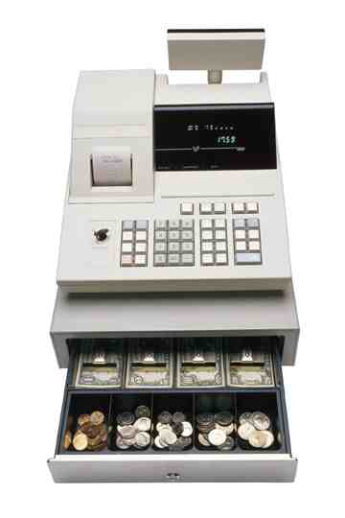

1. Transaction Processing Systems (TPS)
Activities:
  Transaction handling
  Record-keeping
Action documents
Scheduled reports
Primarily support:
  Clerical personnel
  Operational-level managers
Inflexible
MIS
DSS
EIS

Slide 6
2. Management Information Systems
Transaction Processing Systems (TPS)
  Support operation
  Management and control
  Routine, normal operations
Management Information Systems (MIS)
  Provide decision-making support for routine, structured decisions
  Closely linked to and fed by TPS

Slide 7
Management Information Systems
Terminology Confusion
  MIS = the study of information technology in business settings
  But, MIS is also term to refer to class of systems used to support operational and tactical decisionmaking

Slide 8
A Model for Problem Solving
Decision Making Phase
  Intelligence gathering
  Design
  Choice
Implementation
Monitoring

Slide 9
Decision Making
A step in problem solving
Intelligence gathering
  Definition of problem
  Data gathered on scope
  Constraints identified
Design phase
  Alternatives identified and assessed
Choice
  Selection of an alternative

Slide 10
Structured vs. Unstructured Problems
Structured problems lend themselves to programmed decisions
  The implication is that a repeatable process can be employed and these can be automated
Unstructured problems require unprogrammed decisions

Slide 11
Making Decisions
Well-Defined Problem
Programmed
Decisions
Unstructured Problem
Information-Based
Decisions

Slide 12
Unstructured Problems
Can be addressed (or partially addressed) with Decision Support Systems

Slide 13
Structured Problems
Can be addressed by an MIS
Three decision models or techniques
  Optimization
    Find the best solution
  Satisficing
    Find a solution which meets certain criteria
  Heuristics
    Rule-based solution generation

Slide 14
Goals of an MIS
Provide managers with information
Regular, routine operations
Control, organize and plan better

Slide 15
Typical Inputs and Outputs
Inputs: Information from the TPS
Outputs: hard and softcopy reports
  Scheduled reports
  On-demand reports
  Key-indicator (business fundamentals)
  Exception reports

Slide 16
Functional Perspectives of MIS
Financial MIS
  Will integrate information from multiple sources
  Functions
    Costing
    P&L reporting
    Auditing
    Funds management

Slide 17
Functional Perspectives of MIS
Manufacturing
  Design and Engineering
  Master Production Scheduling
  Inventory Control
  Materials Planning
  Manufacturing and Process Control
  Quality Control

Slide 18
Functional Perspectives of MIS
Marketing
  Market research
    Web-based market research
  Pricing

Slide 19
Functional Perspectives of MIS
Transportation and Logistics
  Route and schedule optimization
Human Resources
Accounting

Slide 20

3. Decisions Support Systems
interactive
integrated set of hardware and software tools
produce information to support decision-making process

Slide 21
Decision Support Systems
Used for unstructured problems
Characteristics
  Data from multiple sources internal and external to organization
  Presentation flexibility
  Simulation and what-if capability
  Support for multiple decision approaches
  Statistical analysis

Slide 22
Components of a DSS
Model management software
  Provides a variety of solution models
    Financial, statistical, graphical, project management
Dialogue Manager
  Allows user interaction with DSS

Slide 23
Group Decision Making Systems
Very interesting field
How can information technology improve how decisions are made by groups?

Slide 24
Group Decision Making Systems
Applications
  Where time is critical
  Where participants are geographically dispersed
  Where authority obstructs communication
  Military
  Business
  Government

Slide 25
Group Decision Making Systems
Common characteristics
  Meeting moderation/facilitation
  Signed and anonymous comments
  Structured deliberations
    Presentation period
    Comment period
    Automated collation of comments
    “Voting”
Face-to-face and remote

Slide 26
DSS vs. MIS
MIS:
structured problems
designed to support a set of applications
DSS:
semistructured and unstructured problems
can be adapted to any decision environment

Slide 27
4. Executive Information Systems
What information does a chief executive of board member require?

Slide 28
Executive Information Systems
High level with drill down
Key business and industry data
Structured and unstructured information
  Structured: orders
  Unstructured: Industry newsfeed
Graphical

Slide 29

EIS – DSS with a twist
Executive Information System
Just DSS for executives
Each tool is designed specifically to support decision making at the executive levels of management
  Primarily the tactical and strategic levels

Slide 30

Expert Systems
An Expert System is an interactive system
  Responds to questions
  Asks for clarification
  Makes recommendations
  Helps the user in the decision-making process
Simulates human thought process
  Reasons, draws inferences & makes judgments (heuristic knowledge)
Information acquired from live domain experts
Highest form of knowledge-based systems, not an assistant system

Slide 31
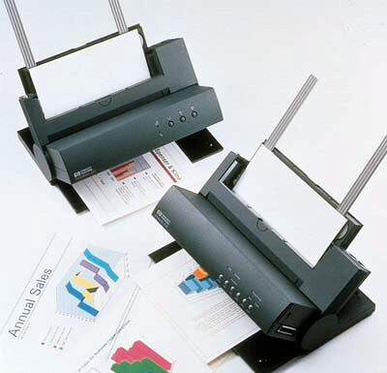
Expert System Example
Printer - Replace technical support people
Diagnosis help (you relate symptoms and it asks for more info)
Assistant system (call center; life ins quotes)
Knowledge base contains
  Means of identifying problem
  Possible solutions
  How to progress from problem to solution

Slide 32
Week 3 – Application of MIS
TPS: Mobile payments.
MIS: Customer usage reports.
DSS: Predicting usage trends.
ESS: Market expansion dashboards.

Slide 33
Week 3 – Discussion Questions
1. How do TPS and MIS work together in M-Pesa?
2. Why does Safaricom need DSS and ESS?

